Slide 1
Prayer
Ministry
Seminar

Slide 2


A Balanced & Effective
Prayer Life
Daily
Devotion
Spirit
Understanding
Relationship
Prayer
(Upward Focus)
Dominion
Prayer
(Outward Focus)
Prayer 101
Transformation
Prayer
(Inward Focus)

Slide 3
Why
Do We
Need to
Pray

Slide 4
Theme
“CLOSER”
“When you draw close to God, God will draw close to you.”
James 4:8 TLB

Slide 5
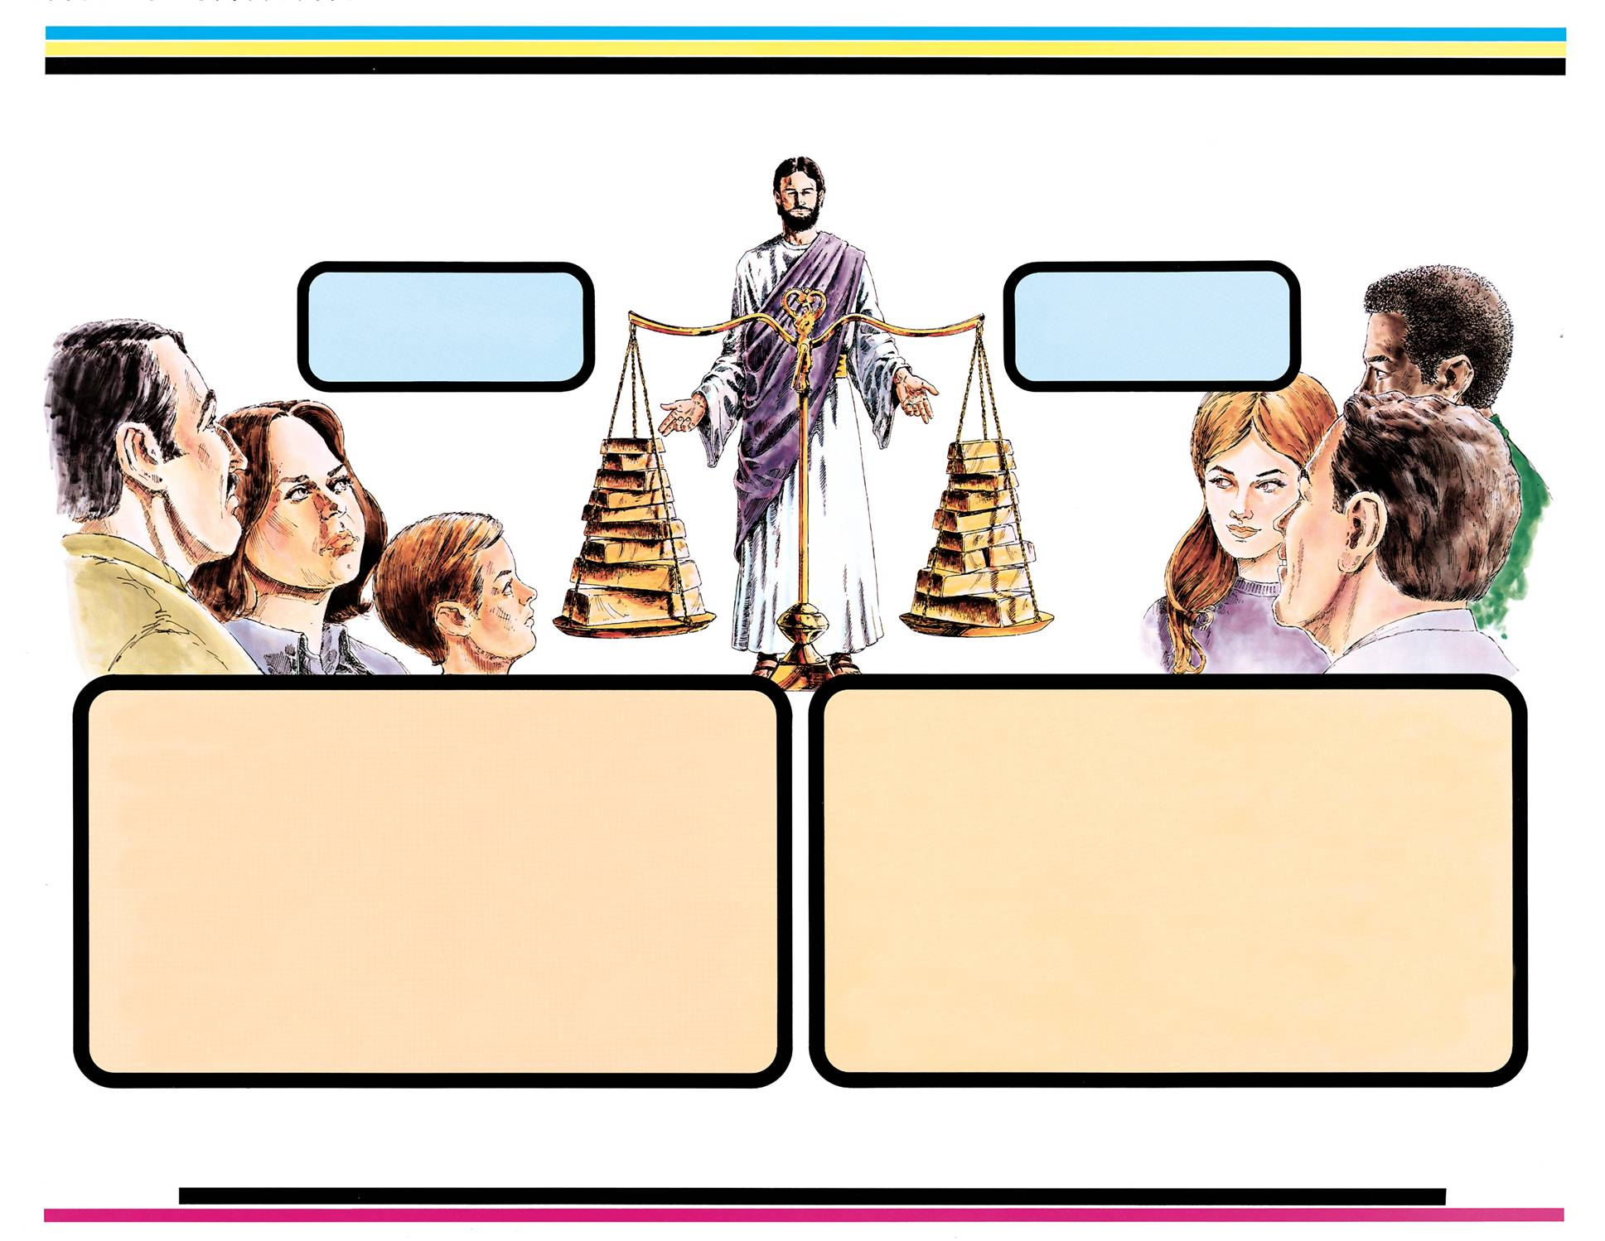
LIVING A BALANCED LIFE
Natural
Spiritual
• Family time
• Finances
• Hobbies
• Reading
• Recreation
• Shopping
• Fellowship
• Prayer
• Bible study
• Meditation
• Church
• Tithes;
offerings
• Family
devotion
• Praise
• Fasting
• Sharing gospel
• Good deeds
• Teaching
• Praying for sick
• Fellowship
• Sleep
• Occupation
• Education
• Household
duties
• Meals
• Personal
grooming
Do you have a balanced
and effective Prayer Life?
Building up yourselves on your most holy faith,
praying in the Holy Ghost. Jude 20

Slide 6
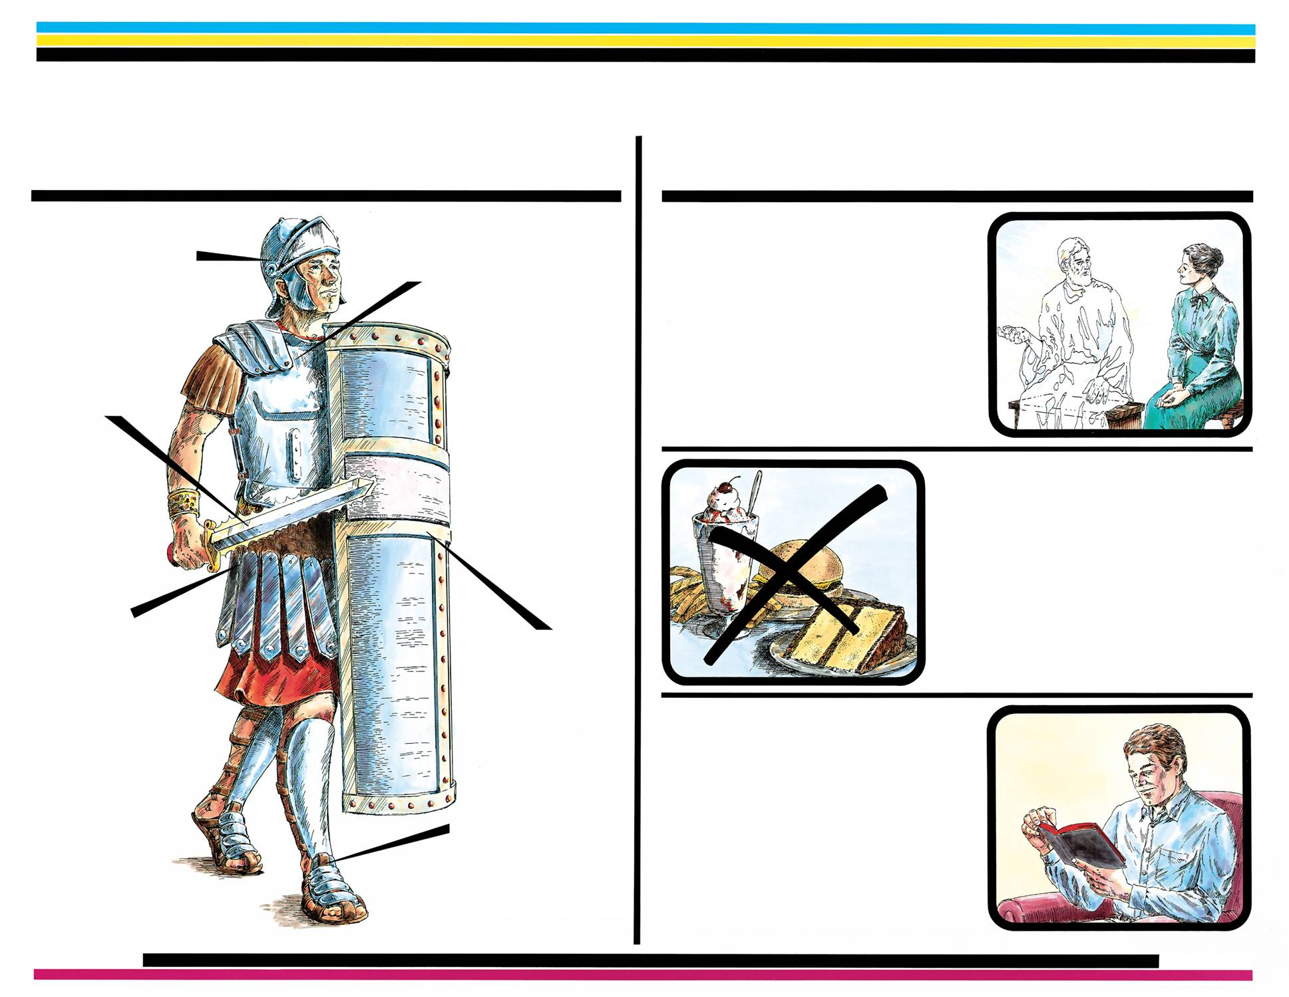
LIVING A VICTORIOUS LIFE
CONQUERING THE ENEMY
Spiritual Armor Ephesians 6:10-18; Isaiah 59:17
Sources of strength
Prayer
(developing a
Relationship
with the King)
Matthew 6:6; Psalm 91:1; John 9:31; 15:7;
Romans 8:26-27; I Thessalonians 5:17;
I John 3:22
Helmet of
Salvation
Breastplate of
Righteousness
Sword
of the
Spirit
Fasting
(a physical
descipline for
spiritual
alertness)
Matthew 6:16-18; Acts 13:2-3;
Mark 9:29; Joel 1:14; 2:12; Isaiah 58:6-8
Loins
girded
with
Truth
Shield of
Faith
Bible study
and meditation
(practicing
kingdom
concepts)
Joshua 1:8; Proverbs 4:4;
Psalm 1:2-3; 119:97, 99
Feet shod
with Gospel
of Peace

Slide 7
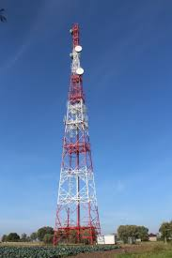

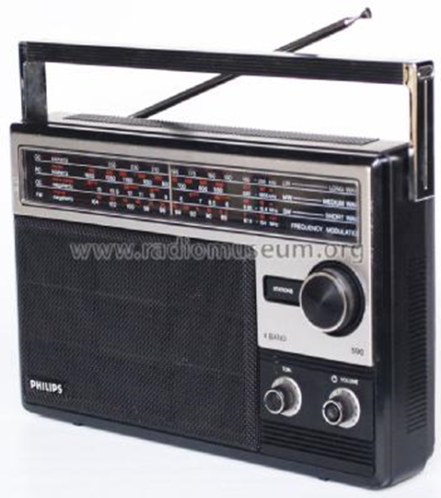
In any communication system there is a transmitter and a
receiver. But to receive the message the receiver must
be plugged in, turned on, and tuned in to the station.
.
TRANSMITTER
God is always speaking to us through the written Word, the preached Word, dreams, visions, His still small Voice
and at times His audible Voice.
RECEIVER
>>>>>>>>>>>>>>>>>
TALKING TO GOD IN PRAYER COMPLETES THE COMMUNICATION CYCLE
AND TUNES OUR SPIRITUAL EARS TO HEAR AND UNDERSTAND GOD’S VOICE.
He that hath an ear [spiritual ear] to hear, let him hear what the Spirit is saying.
(Recorded 6 times by Jesus in the gospels and 8 times by John in Revelation.)

Slide 8
IF YOU PRAY ON YOUR BEST DAY-
YOU WON’T HAVE TO PRAY ON YOUR WORST DAY!

Slide 9
Praying with the understanding (known tongues) and praying in the Spirit (unknown tongues) will enrich your personal prayer life.
Praying in the Spirit is the highest level of intimate communication with God.
1 Cor. 14:14 - 15
14 For if I pray in a language I don't understand, my spirit is praying, but I don't know what I am saying.
15 Well, then, what shall I do? I will do both. I will pray in unknown tongues and also in ordinary language that everyone understands. I will sing in unknown tongues and also in ordinary language so that I can understand the praise I am giving;
Jude 20
But ye, beloved, building your most holy
faith, praying in the Holy Ghost.
Balanced & Effective Prayer
Praying in the Spirit
Praying with the Understanding

Slide 10
Isaiah’s vision, recorded in Isaiah Chapter 6, illustrates the three significant elements included in a balanced and effective prayer life:
(1) Relationship prayers: an upward vision of God (the need for a renewed
and elevated relationship).
(2) Transformation prayers: an inward vision of himself (the need for
repentance and transformation).
(3) Dominion prayers: an outward vision of the world (answering God’s call
to pray for and minister to the needs of the world).
Prayer
Relationship
Prayers
(Upward Focus)
Transformation
Prayers
(Inward Focus)
Dominion
Prayers
(Outward Focus)
Prayer

Slide 11
1. Relationship Prayer
(The focus is talking to God and listening for His still small Voice)
Thanksgiving: Thanking God for what He has done -
(spiritual, relationship, physical blessings)
Praise & Worship: Confessing who God is -
(His greatness: Wonderful, Counsellor, Mighty God,
Everlasting Father, Prince of Peace)
Supplication: Request for my needs to be supplied
2. Transformation Prayer
(The focus of need is for me to be transformed -- changed)
Confession: Repentance of sin and self
Transformation: Change me prayers
- Less of my will and more of His
- Less of my thoughts and ways and more of His
- Less of my limited human love and more of His perfect love
- Ask God to help me identify and remove hindrances to the
flow of His love and power through my life
3. Dominion Prayer
(The focus of need is for others)
Intercessory Prayers: Standing between God and man, interceding for our lost neighbor, city and world
Intercessory Prayers (Spiritual Warfare): Standing between Satan and man (binding the powers of Satan that have bound and blinded them)
Praying for God to help us walk in the dominion and authority we have been given as a son of God

Slide 12
Our focus is upward: adoration of our
great God, making our petitions
known and listening for His Voice.
Thanksgiving:
Thanking God for His love and blessings:
- Spiritual Blessings (salvation, knowledge of truth)
- Relationship Blessings (family and friends)
- Physical Blessings (Resources He has graciously
given us to manage):
- Time (years of life)
- Health (strength to enjoy life and do His will)
- Wealth (finances and possessions)
- Protection from: harm, danger, sickness, and disease
“Enter into his gates with thanksgiving, and into his courts with praise be thankful unto him, and bless his name.” (Psalms 100:4)
Praise & Worship:
Acknowledging God’s Goodness & Greatness:
- His goodness: loving, forgiving, merciful, gracious, kind,
faithful, long suffering, generous, burden bearer . . .
- His greatness: supernatural, omnipotent, omniscient,
omnipresent, eternal, healer, ruler of the universe . . .
Petitions:
Request for my needs to be supplied: health, family,
finances, careers, decisions, relationships, protection . . .
1. Relationship Prayer

Slide 13
Our focus is inward: the need to be transformed -- continuously changed.
“Be ye transformed by the renewing of your mind, that you may prove what is the good and acceptable will of God.” (Rom. 12:2)
“There are given unto us exceeding great and precious promises: that by these ye might be partakers of His divine nature.”
(2 Peter 1:4)
Confession & Repentance:
- A plea for cleansing and forgiveness (Psalms 51)
- Repentance for any pride or self-righteousness
- Asking God to correct me with His written Word,
preached Word, man of God, His still small Voice . . .
Transformation: (Change me prayers)
- Less of my will and more of His
- Less of my mind and ways and more of His
- Less of my limited love and more of His agape love
- Asking God to help me to identify and remove any
hindrances to the flow of His love and power
through my life
- Renewal of the Holy Ghost: “Building up yourselves on
your most holy faith, praying in the Holy Ghost.” (Jude 20)
He must increase and I must decrease !
2. Transformation Prayer

Slide 14
Our focus is outward: the needs
of people for healing and salvation.
Intercessory Prayer (friendly forces):
Standing between God and man, weeping and
interceding for our lost neighbors, city, and world.
Spiritual Warfare (unfriendly forces):
Standing between Satan and man and binding the
powers of evil that have bound and blinded them
from coming to the light of the Gospel and the
knowledge of Jesus Christ.
God’s Direction and Wisdom:
Praying for God’s wisdom and direction to know
how to most effectively reach our lost world.
Praying Prophecies into Fulfillment:
Praying into fulfillment the promises and
prophecies in God’s Word regarding the complete restoration of the church with apostolic power and dominion over Satan and sickness.
“He called His twelve disciples together, and gave them power and authority over all devils and diseases.” (five-fold ministry)
“The Lord appointed seventy also . . . heal the sick . . . I give you power over all the power of the enemy.” (the laity)
3. Dominion Prayer

Slide 15
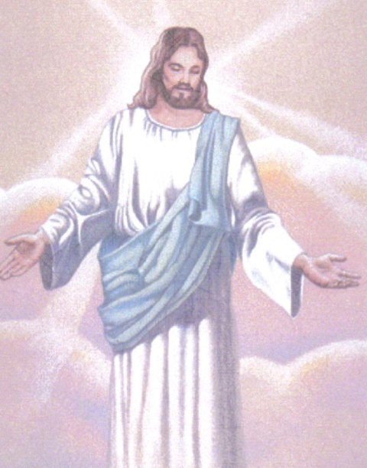
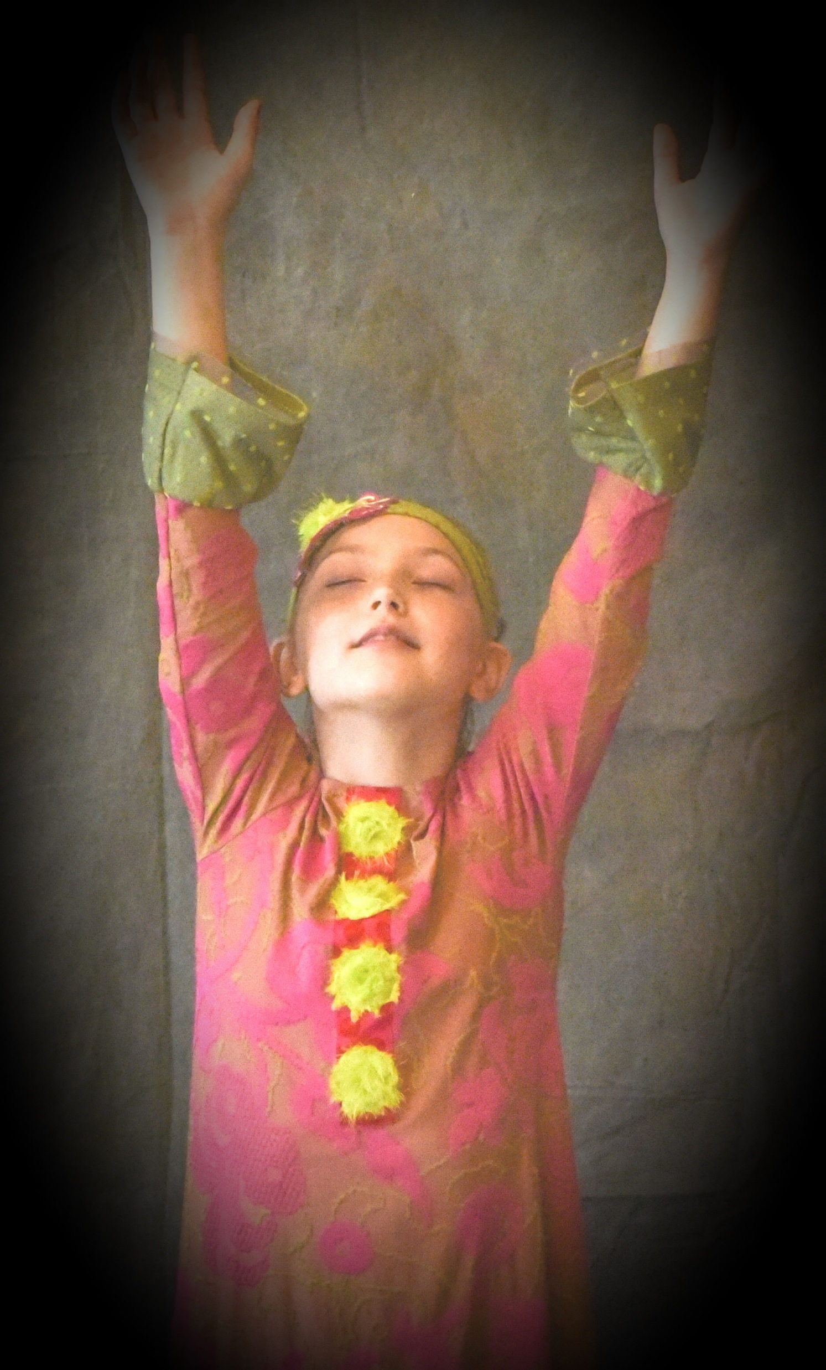

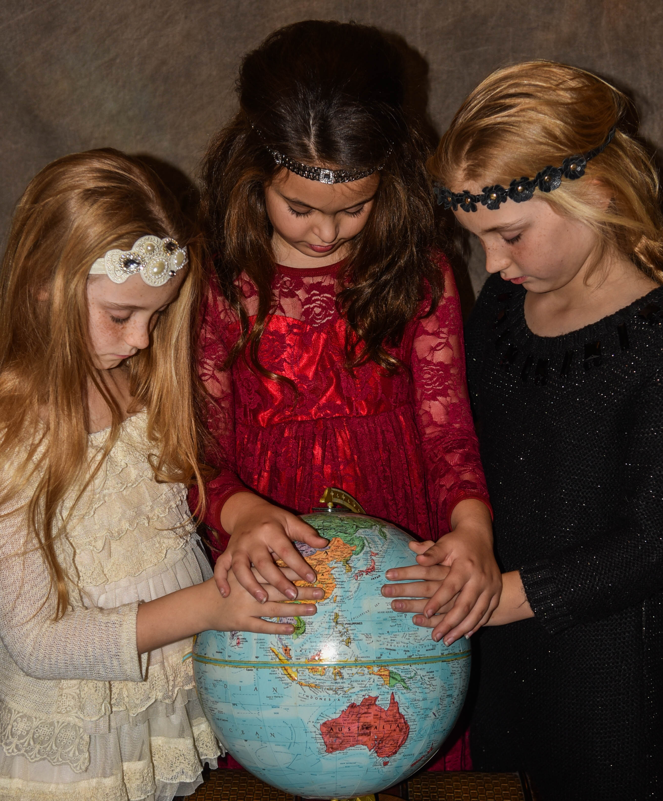
Teaching Children to Pray
C
I am so big and strong that I can do anything!
I am so close that you can touch Me in prayer!
A
B
C
Thanking and
praising Jesus
for His blessings.
Asking Jesus for
the things I need.
Asking Jesus
  to forgive me.
Asking Jesus to
help me be more
like Him.
Praying for others in need.
Praying for
children in
other countries.
Thank
You
Change
Me
Help
Others
Relationship
Prayer
Transformation
Prayer
Dominion
Prayer

Slide 16
LEVELS OF BURDEN, PRAYER & ANOINTING
LEVELS OF BURDEN
(VISION)
LEVELS OF
PRAYER
LEVELS OF ANOINTING
(DIVINE ABILITY)
0. NO BURDEN /
VISION
(MY KINGDOM)
0. PRAYERLESSNESS
0. NO ANOINTING
1. BURDEN FOR
SELF
(PERSONAL)
(MY / HIS KINGDOM)
1. SURVIVAL PRAYER
- SEEKING THE HANDS OF GOD
- MAINTENANCE PRAYER
(Maintaining Our Own
Salvation)
1. PERSONAL
ANOINTING
BEGINS HERE
2. BURDEN FOR
OTHERS
(HIS KINGDOM)
2. REVIVAL PRAYER
- SEEKING THE FACE OF
GOD (Favor & Relationship)
- RELATIONSHIP PRAYER
- TRANSFORMATION PRAYER
- DOMINION PRAYER
2. PUBLIC
ANOINTING
SOUL WINNING
MINISTRY BEGINS &
INCREASES HERE
3. BURDEN OF
THE LORD
(Restoration of the
Church to the book
of Acts & beyond)
(HIS KINGDOM)
3. REVIVAL PRAYER
- SEEKING THE HEART OF
GOD
(Consumed with His Purpose)
- RELATIONSHIP PRAYER
- TRANSFORMATION PRAYER
- DOMINION PRAYER
3. PRIESTLY
ANOINTING
(DOUBLE PORTION)
- INTENSE SOUL
WINNING CONCERN
& MINISTRY
- USED IN THE GIFTS
OF THE SPIRIT
Note: The above is a draft model to be used for teaching prayer and related concepts.
The horizontal lines in the above table are not meant to depict a precise concept.

Slide 17
GOD
The Lord’s
Prayer
1. The Father’s
Character
Our Father which art in
heaven, hallowed be
thy name.
Matt. 6:9
6. The Father’s
Protection
But deliver us
from evil.
Matt. 6:13
2. The Father’s
Kingdom
Thy Kingdom come. Thy
will be done, in earth as
it is in heaven.
Matt. 6:10
Matt. 6:11
Give us this day our
daily bread.
3. The Father’s
Provision
Matt. 6:13
And lead us not
into temptation.
5. The Father’s
Guidance
Matt. 6:12
And forgive us our
sins as we forgive
those who sin against us.
(Forgive to be forgiven 6:14-15)
4. The Father’s
Forgiveness
A Model
for Prayer
MAN

